Slide 1

Whose Reflection?

Slide 2
We’ve evolved 2.44pts more evil this year?
Maximum: 100 / Average: 56.53 / Median: 57.5
Maximum: 99 / Average: 58.97 / Median: 57.5

Slide 3
We’ve evolved 2.44pts more evil this year?
Maximum: 100 / Average: 56.53 / Median: 57.5
Maximum: 99 / Average: 58.97 / Median: 57.5

Slide 4
Somehow, ...
 | P1 | P2 | P3 | P4 | P5 | P6 | P7 | Bonus
Average | 9.89 | 4.80 | 8.83 | 5.49 | 9.76 | 9.75 | 5.75 | 2.25
Total | 15 | 10 | 15 | 10 | 15 | 20 | 15 | 3
Rate | 66% | 48% | 59% | 55% | 65% | 49% | 38% | 75%
Notes:
42% one function for all

Slide 5
Somehow, I unexpectedly saw ...
 | P1 | P2 | P3 | P4 | P5 | P6 | P7 | Bonus
Average | 9.89 | 4.80 | 8.83 | 5.49 | 9.76 | 9.75 | 5.75 | 2.25
Total | 15 | 10 | 15 | 10 | 15 | 20 | 15 | 3
Rate | 66% | 48% | 59% | 55% | 65% | 49% | 38% | 75%
WWPD + EnvDiagram?

Slide 6
WWPD + EnvDiagram
Jiacai Cui
PASCAL Group @ Nanjing University

Slide 7
WWPD: What Would Python Display
Treat yourself as the interpreter!

Slide 8
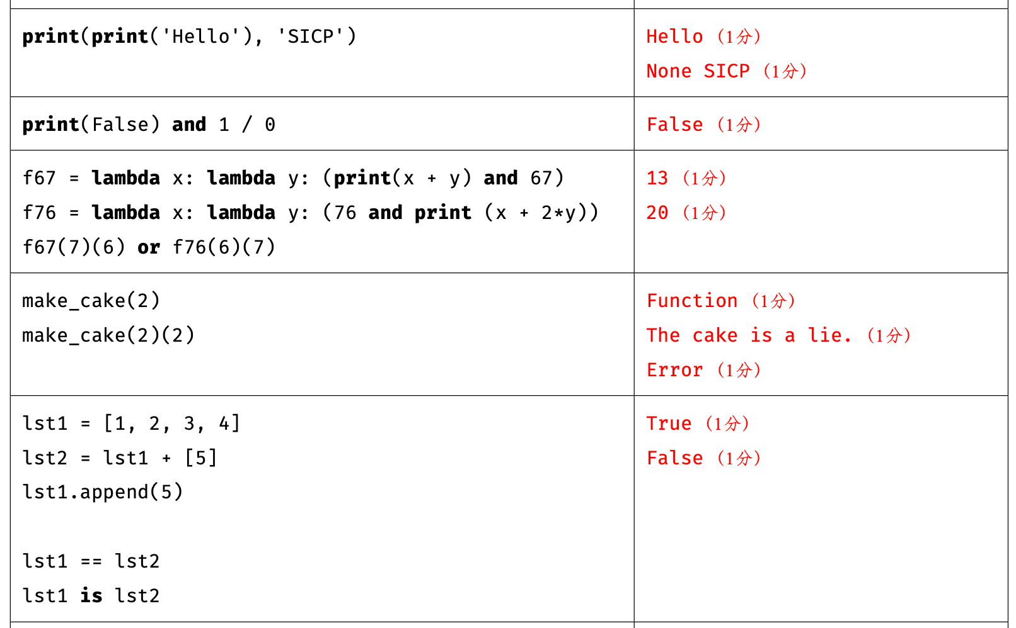

Slide 9
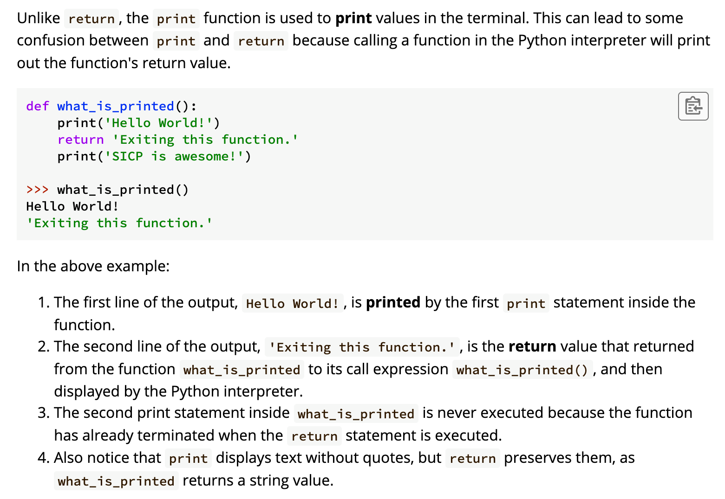
(Lab01, Section 2.1.2, Link)

Slide 10
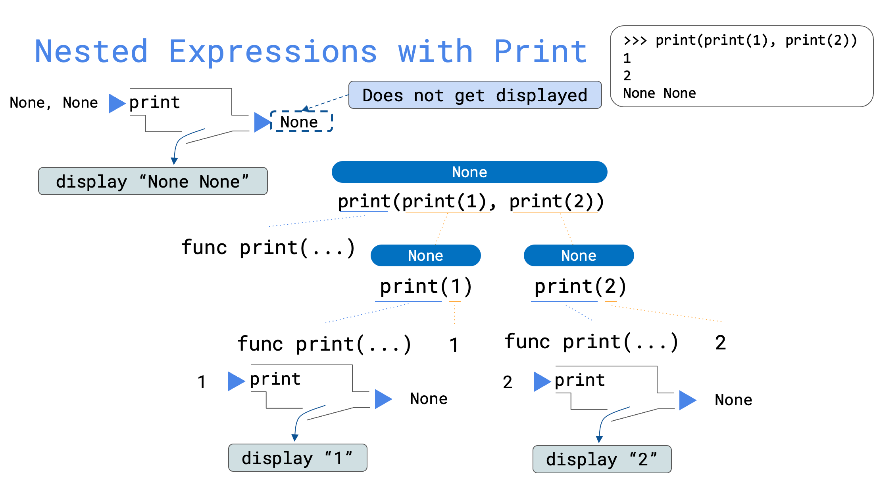
(Sep 21, Control, Slide Page 5)

Slide 12
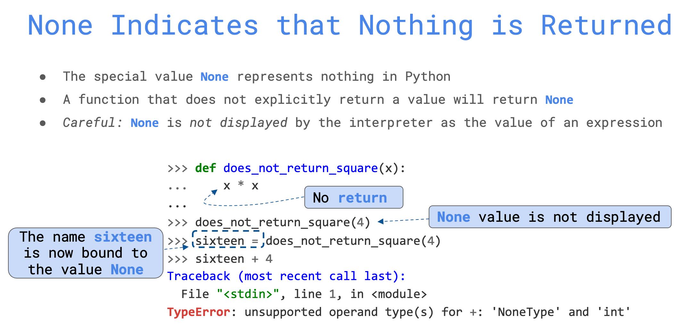
(Sep 21, Control, Slide Page 3)

Slide 13
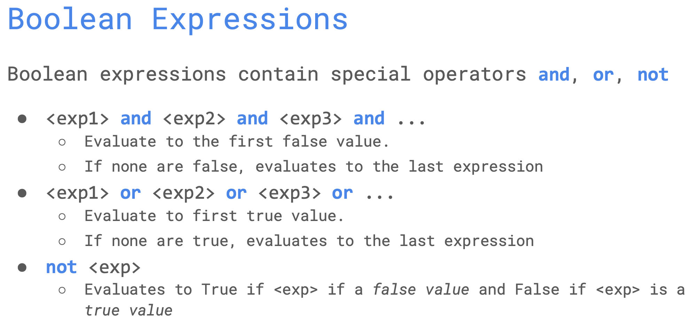
(Sep 21, Control, Slide Page 13)

Slide 14
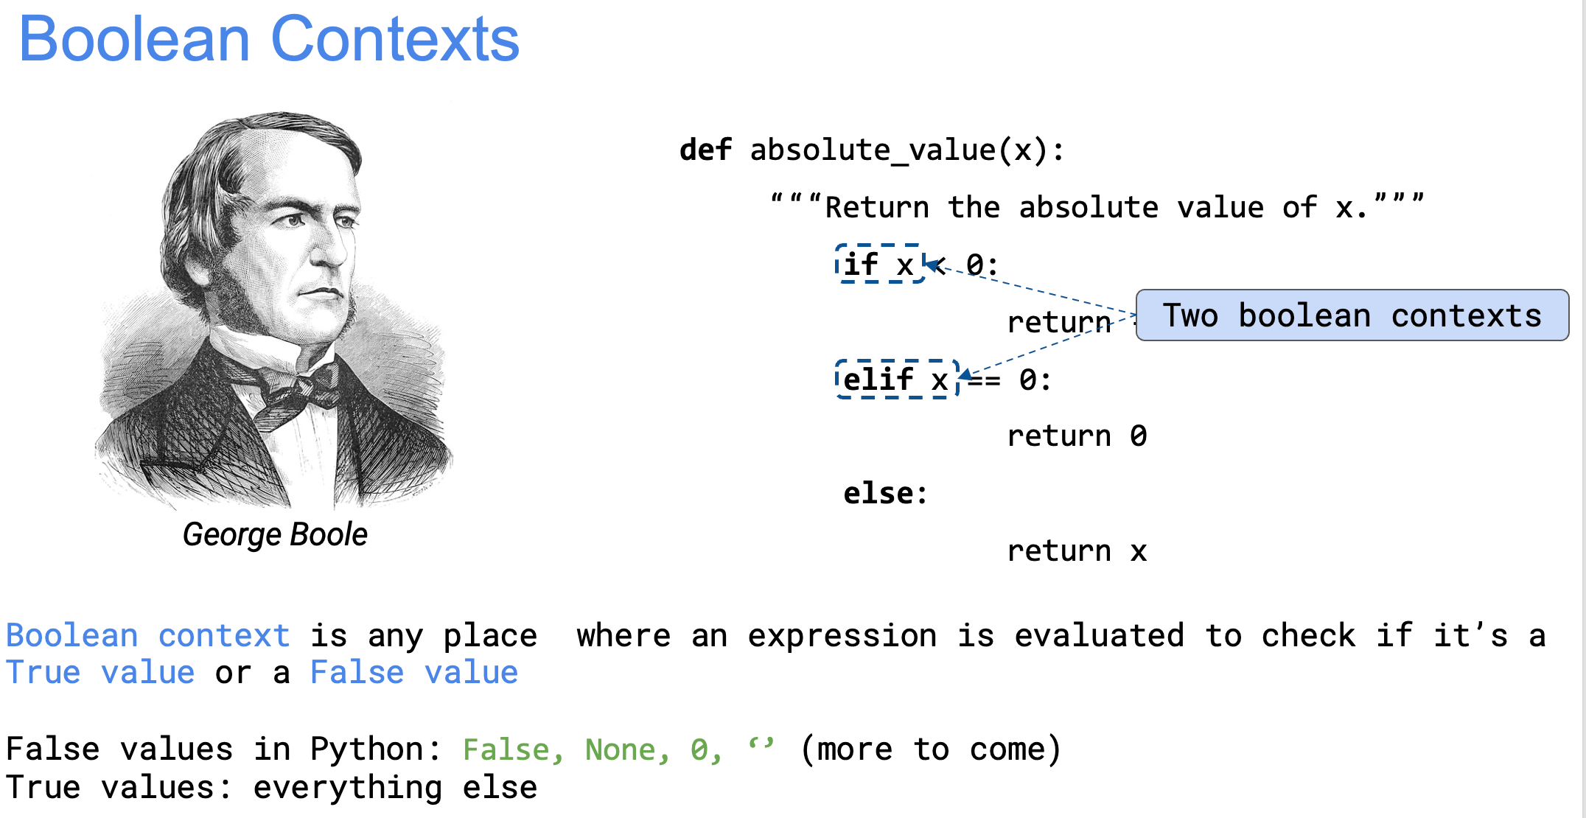
(Sep 21, Control, Slide Page 11)

Slide 15
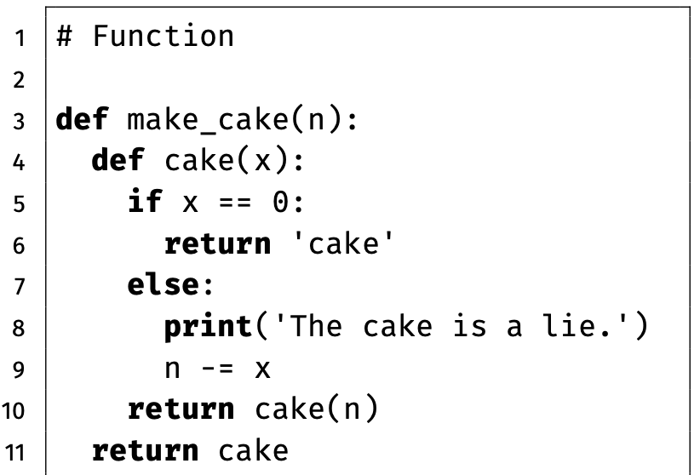

Slide 16
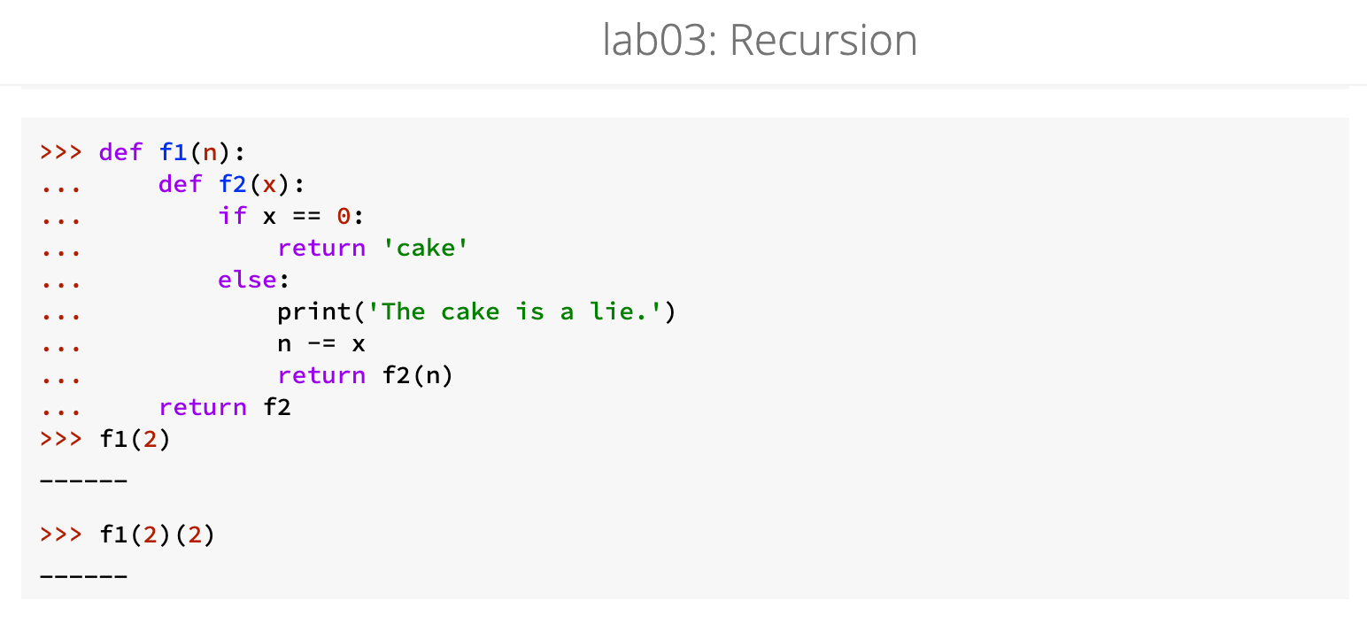
make_cake is f1;
cake is f2.
(Lab03, Question 1, Link)

Slide 17
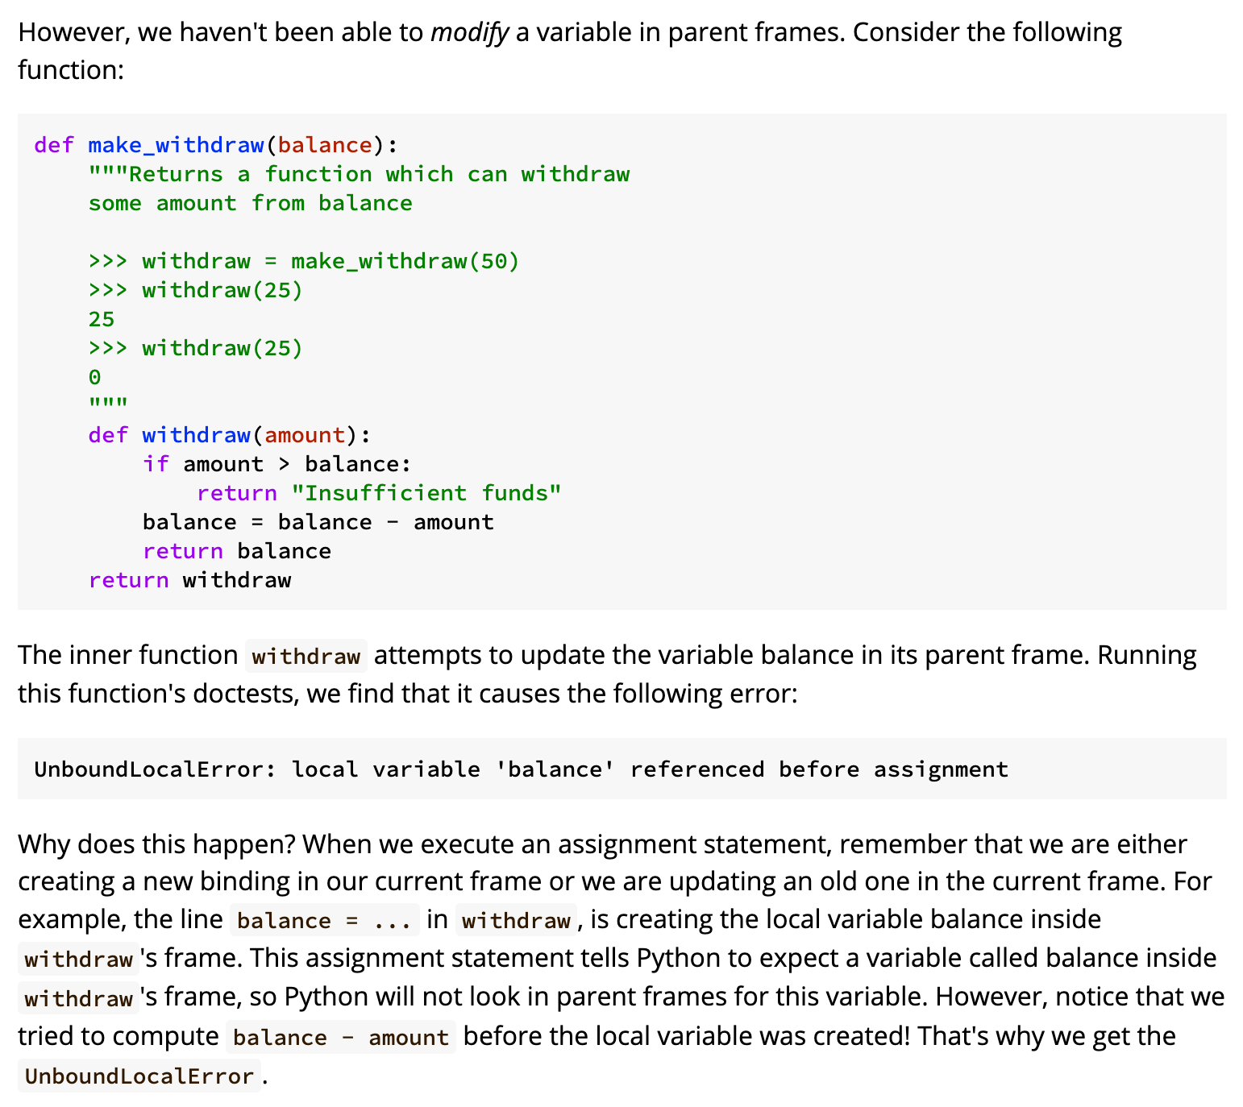
(Lab05, Section 2.1, Link)

Slide 19
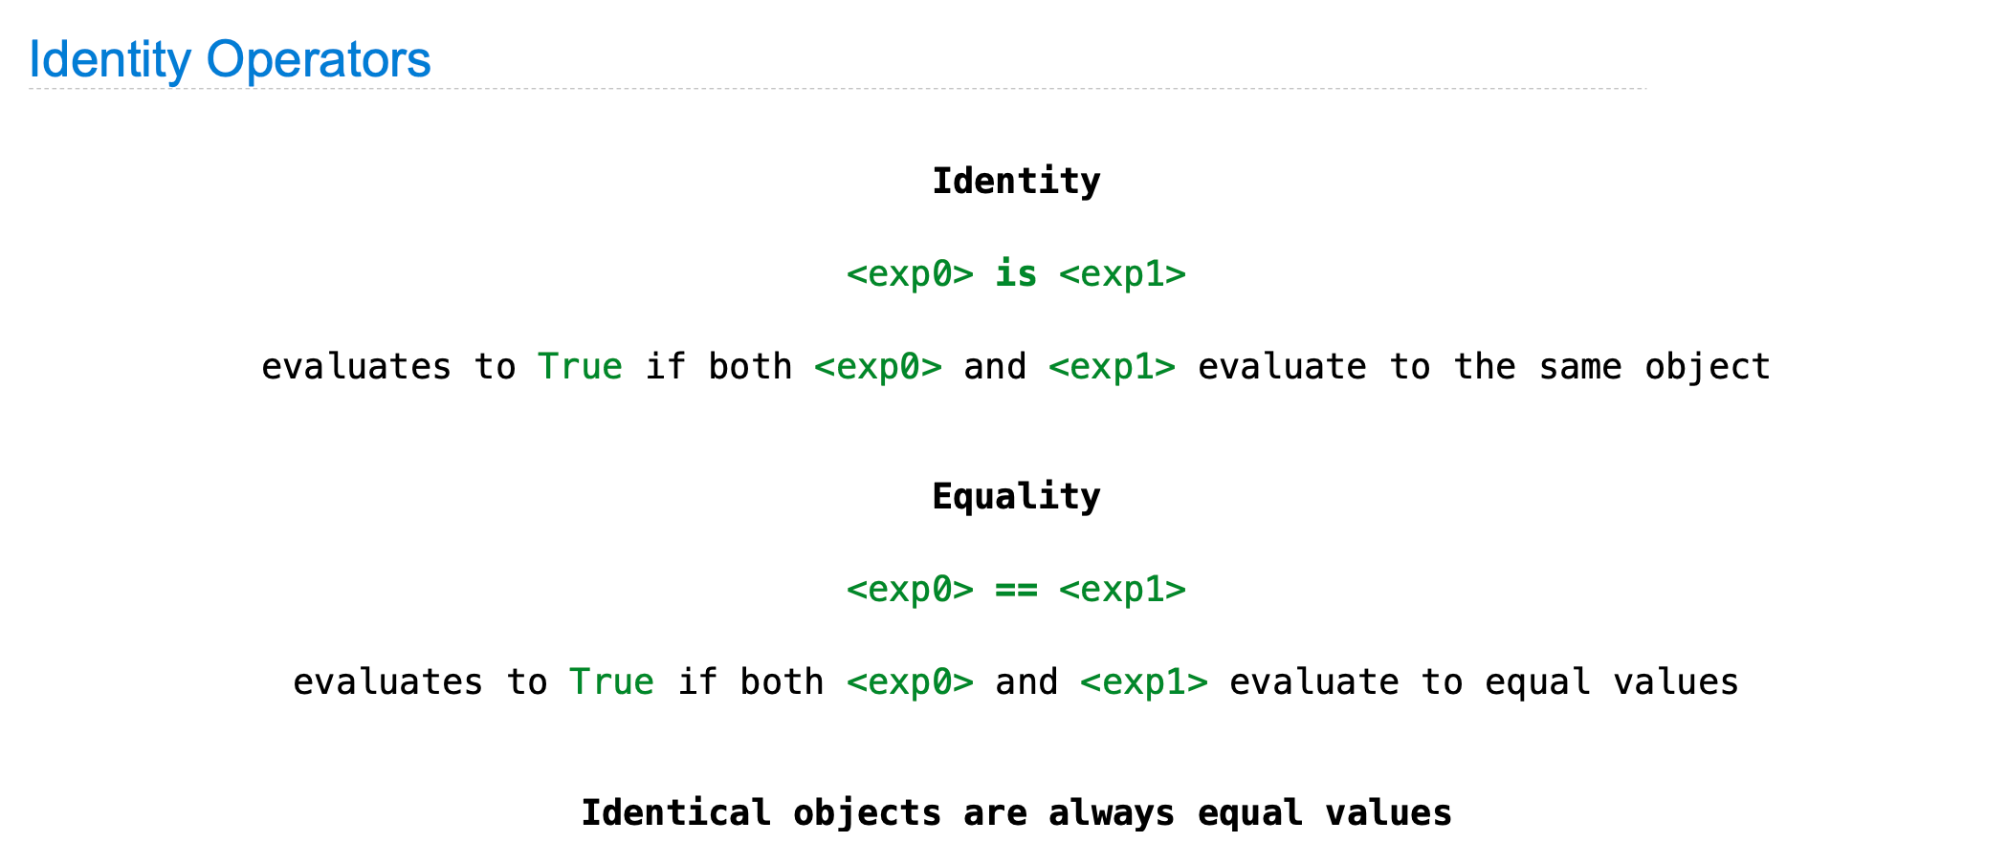
(Oct 21, Mutable Values, Slide Page 74)

Slide 20
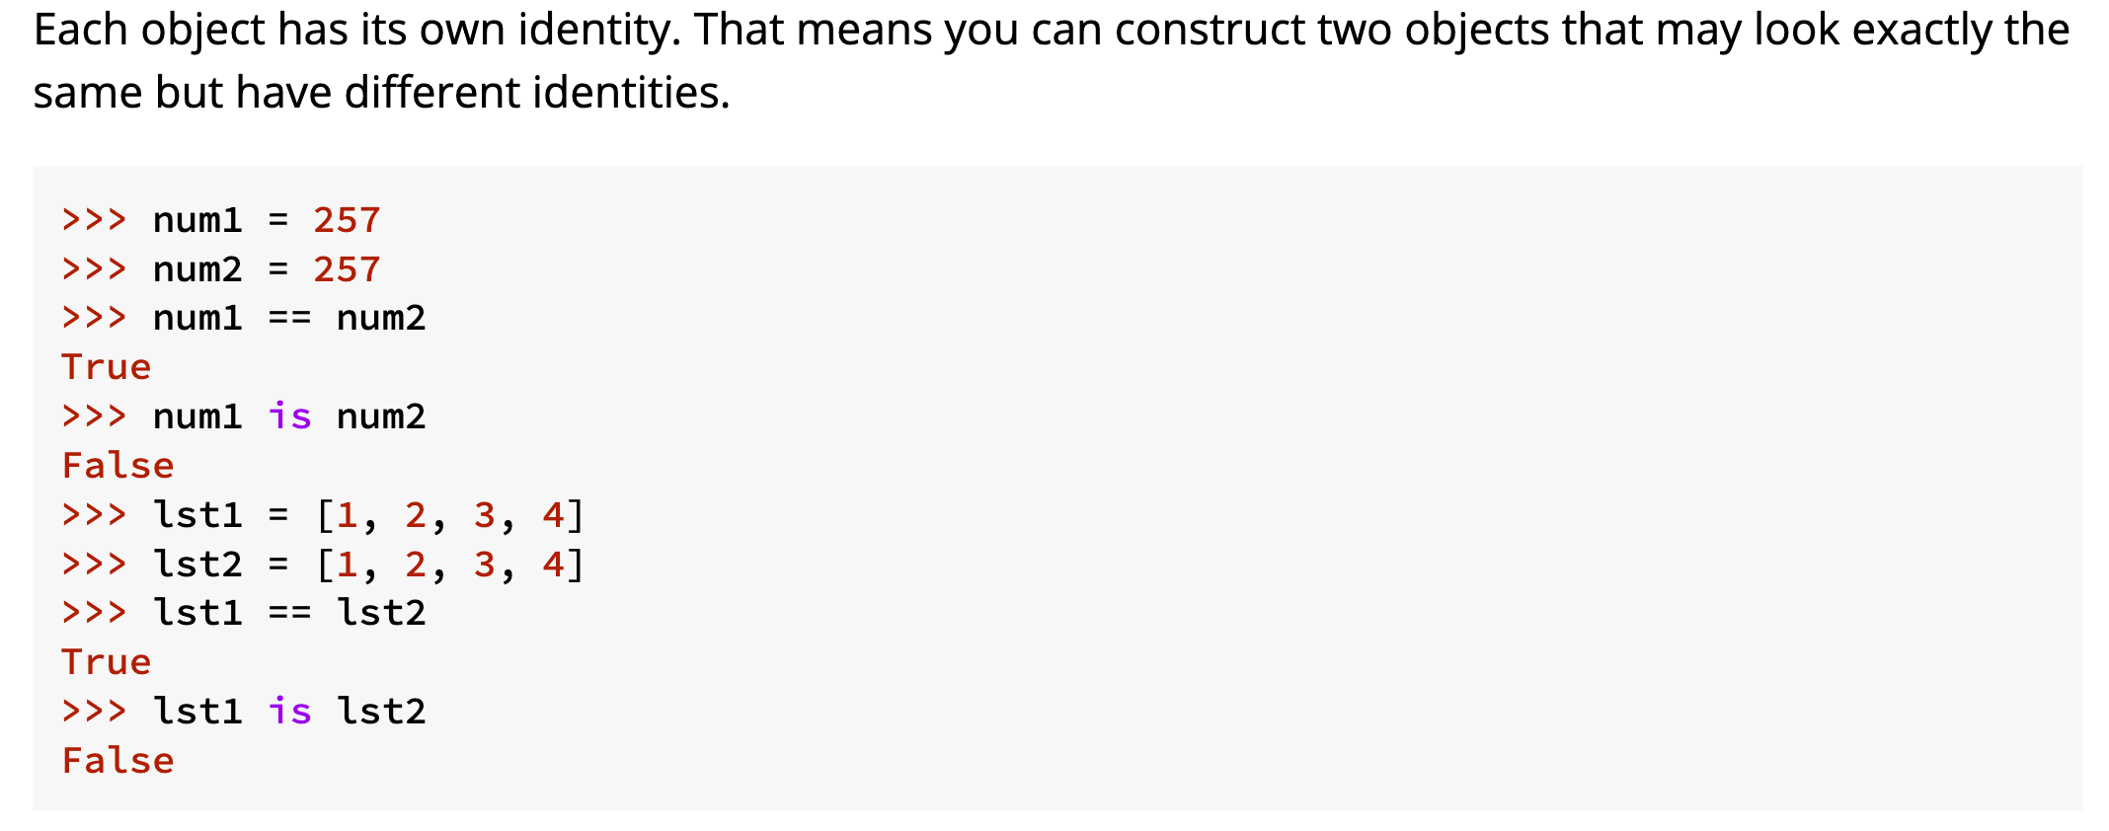
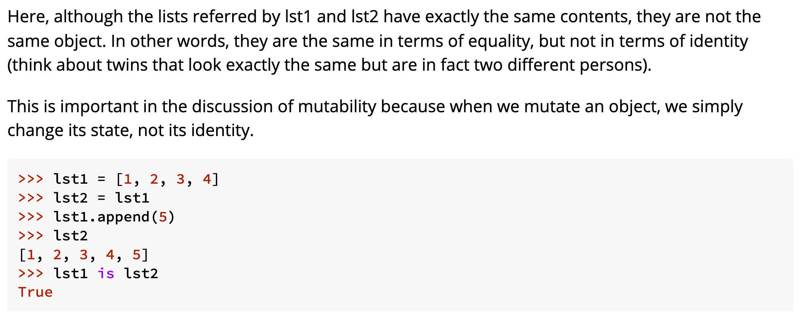
(Lab04, Section 2.5, Link)

Slide 21
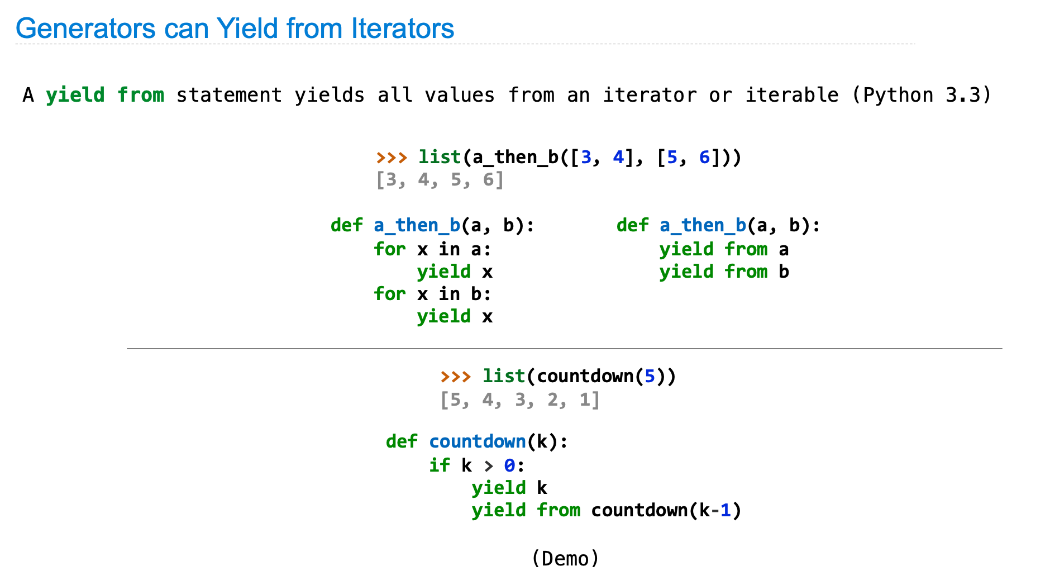
(Oct 28, Iterators, Generators & Lazy Evaluation, Slide Page 70)

Slide 22
def nats(n):
yield n
yield from nats(n + 1)
n
nats(n)
n+1
nats(n+1)
n+2
nats(n+2)
n+3
...
nats(n+3)

Slide 23
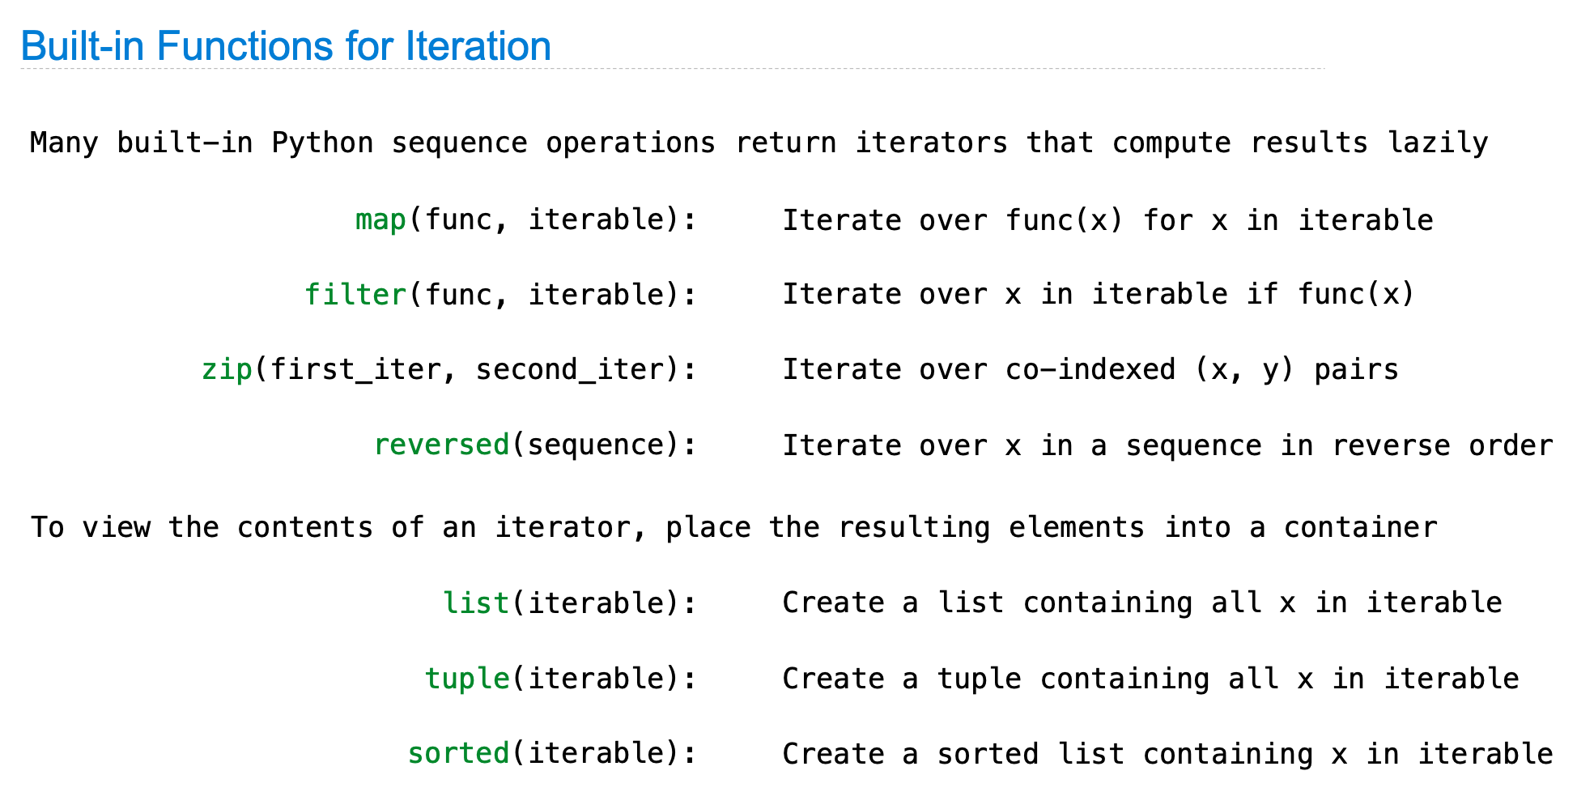
(Oct 28, Iterators, Generators & Lazy Evaluation, Slide Page 49)

Slide 24
def combine(f, xs, ys):
for x, y in zip(xs, ys):
yield f(x, y)
xs
x0
x1
x2
x3
...
f
f
f
f
ys
y0
y1
y2
y3
...
=
=
=
=
f(x0, y0)
f(x1, y1)
f(x2, y2)
f(x3, y3)
...
combine(f, xs, ys)

Slide 25
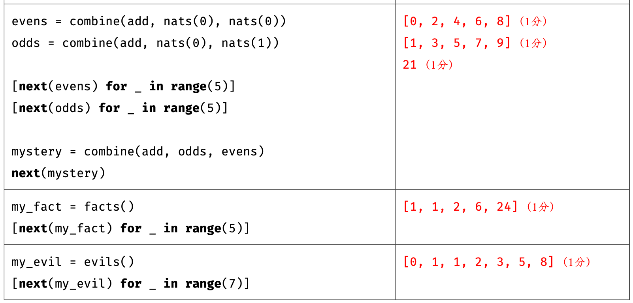

Slide 26
evens = combine(add, nats(0), nats(0))
nats(0)
0
1
2
3
...
+
+
+
+
nats(0)
0
1
2
3
...
=
=
=
=
evens
0
2
4
6
...
combine(add, nats(0), nats(0))

Slide 27
odds = combine(add, nats(0), nats(1))
nats(0)
0
1
2
3
...
+
+
+
+
nats(1)
1
2
3
4
...
=
=
=
=
odds
1
3
5
7
...
combine(add, nats(0), nats(1))

Slide 28
[next(evens) for _ in range(5)]
[next(odds) for _ in range(5)]
evens
10
12
14
16
...
odds
11
13
15
17
...

Slide 29
mystery = combine(add, evens, odds)
evens
10
12
14
16
...
+
+
+
+
odds
11
13
15
17
...
=
=
=
=
mystery
21
25
29
33
...
combine(add, evens, odds)

Slide 31
def facts():
yield 1
yield from combine(mul, nats(1), facts())
1
2
3
4
nats(1)
*
*
*
*
1
1
2
6
facts()
=
=
=
=
1
1
2
6
24
facts()
combine(mul, nats(1), facts())

Slide 32
def evils():
yield 0
yield 1
next_evil = evils()
next(next_evil)
yield from combine(add, evils(), next_evil)
0
1
1
evils()
+
+
+
1
1
2
next_evil
=
=
=
0
1
1
2
3
evils()
combine(add, evils(), next_evil)

Slide 33
def ones():
yield 1
yield from ones()
def nats():
yield 0
yield from combine(add, ones(), nats())
1
1
1
1
ones()
+
+
+
+
0
1
2
3
nats()
=
=
=
=
0
1
2
3
4
nats()
combine(add, ones(), nats())

Slide 34
Environment Diagram
Treat yourself as the python tutor!

Slide 35
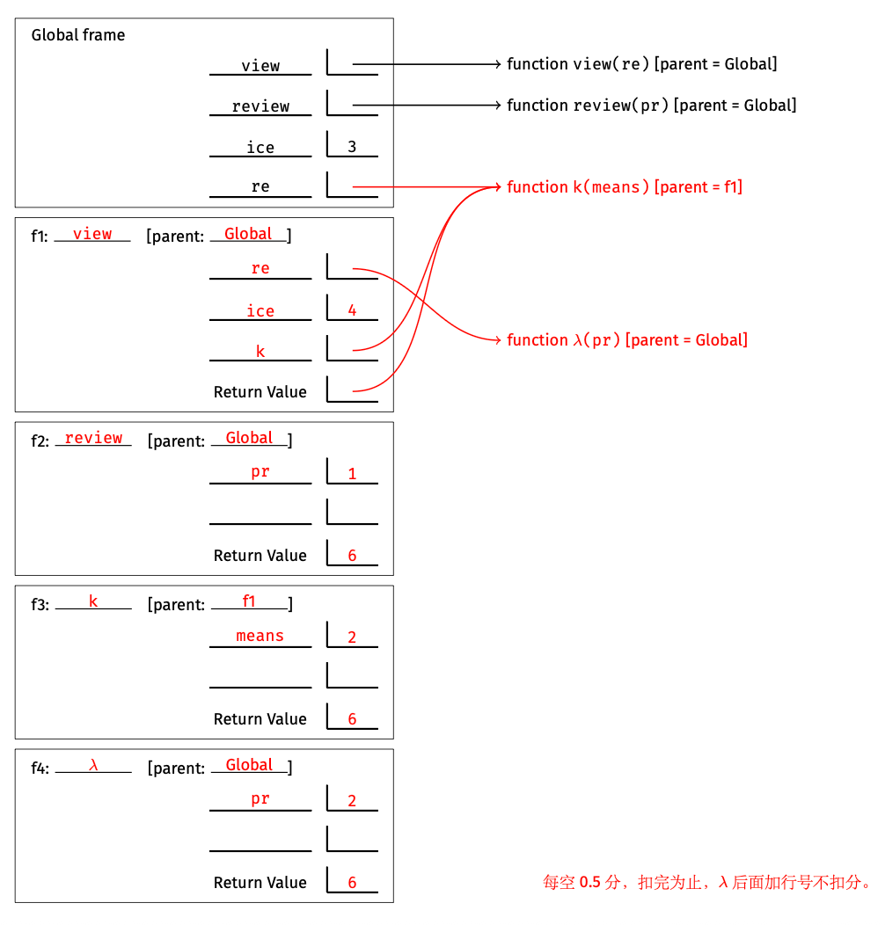
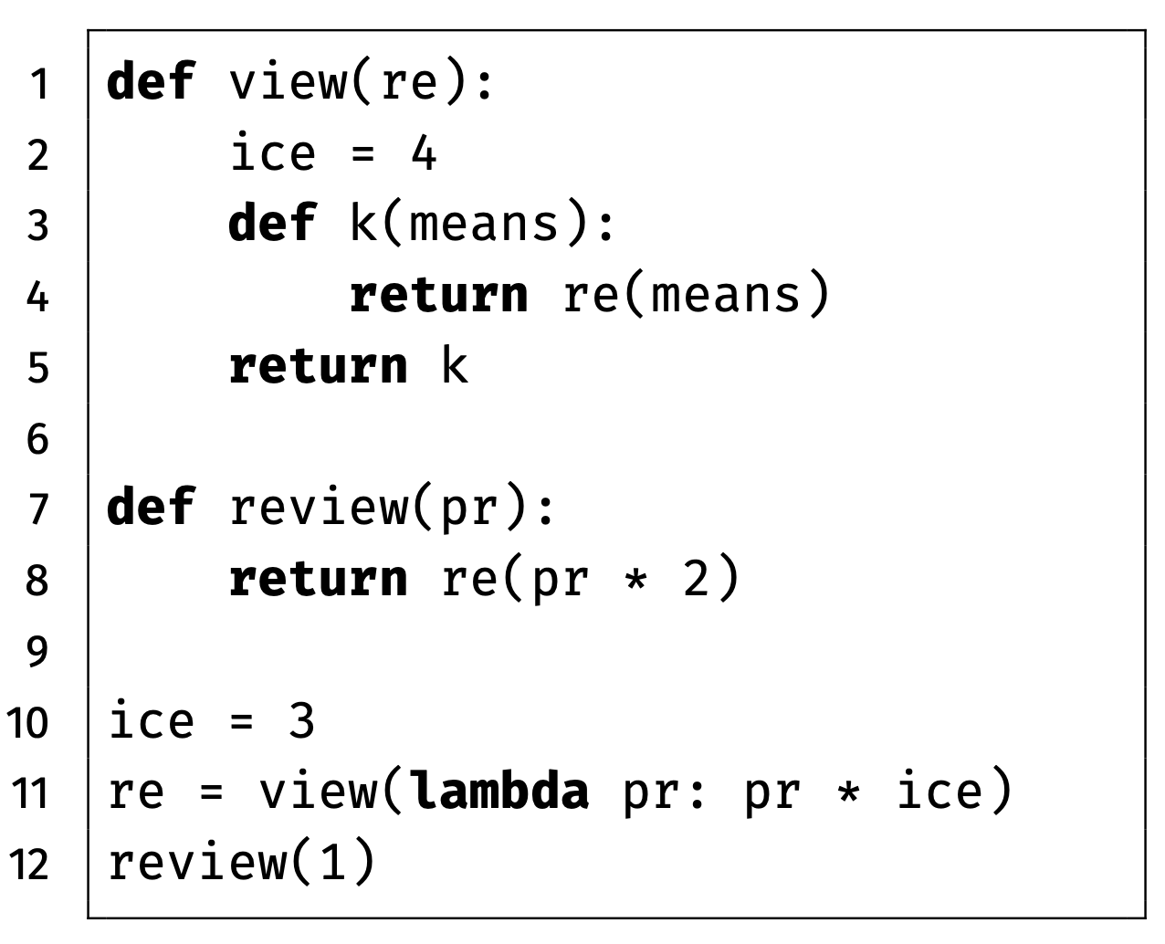
(Tutor Link)

Slide 36
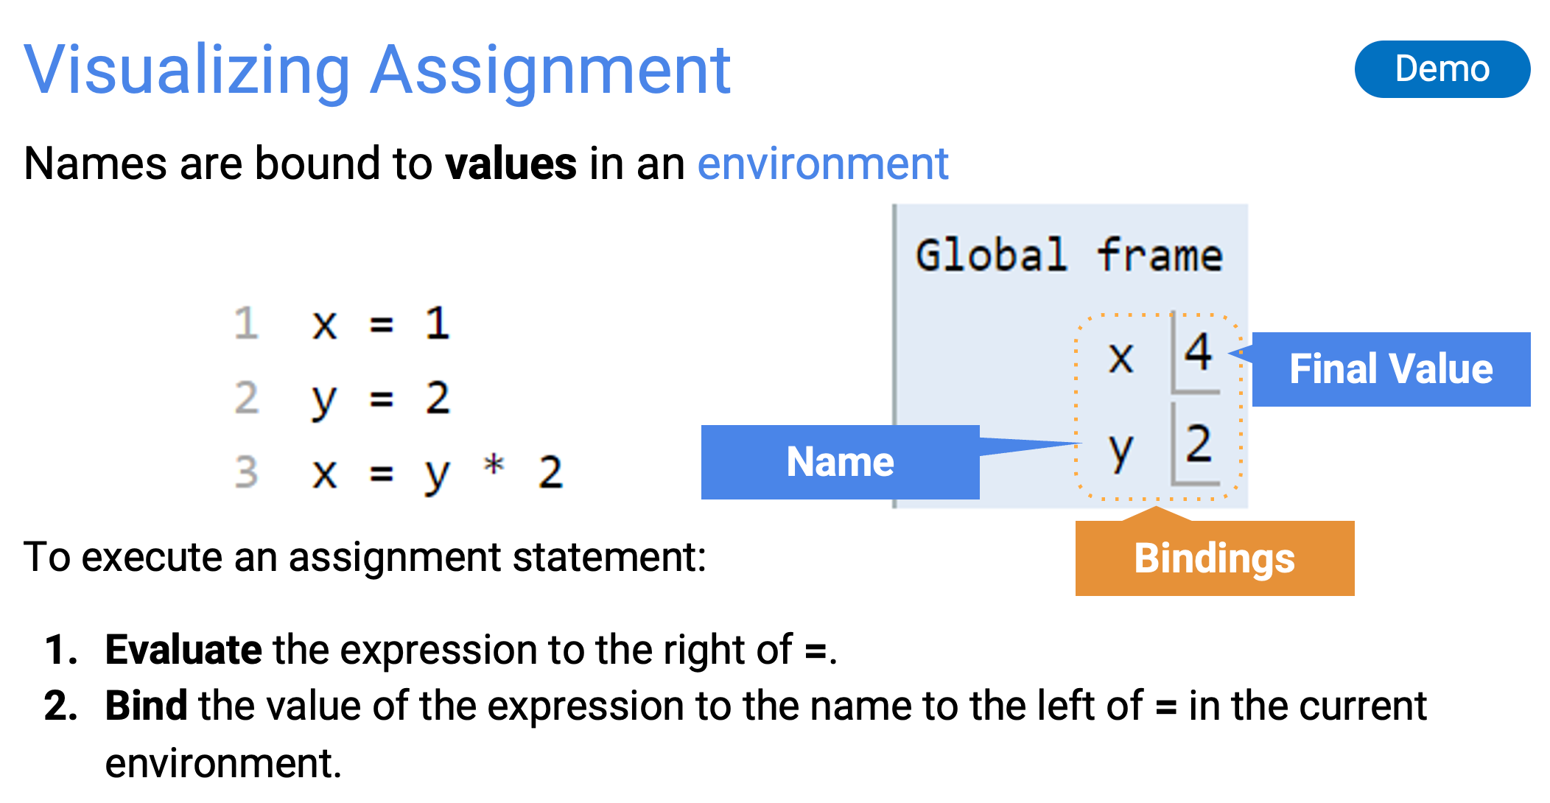
(Sep 16, Names & Functions, Slide Page 10)

Slide 37
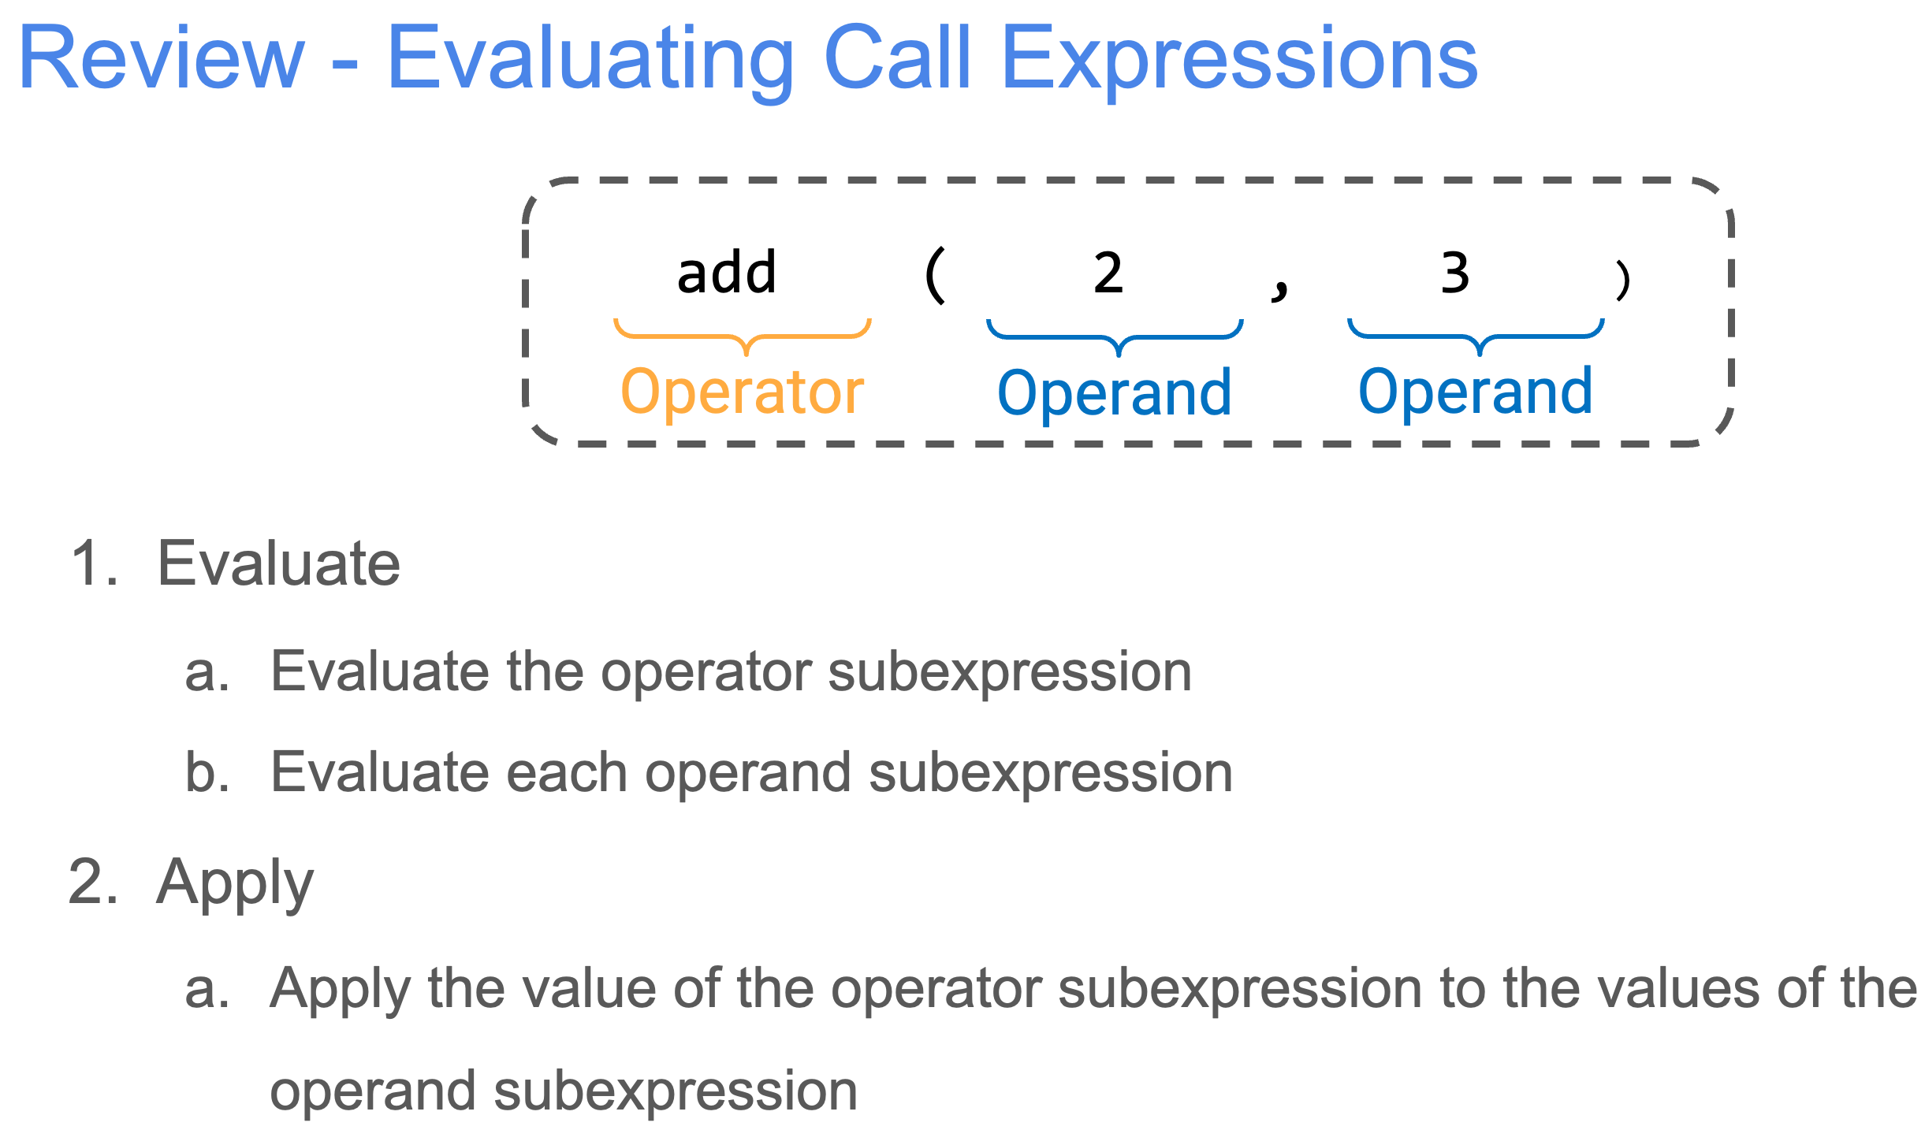
(Sep 16, Names & Functions, Slide Page 4)

Slide 38
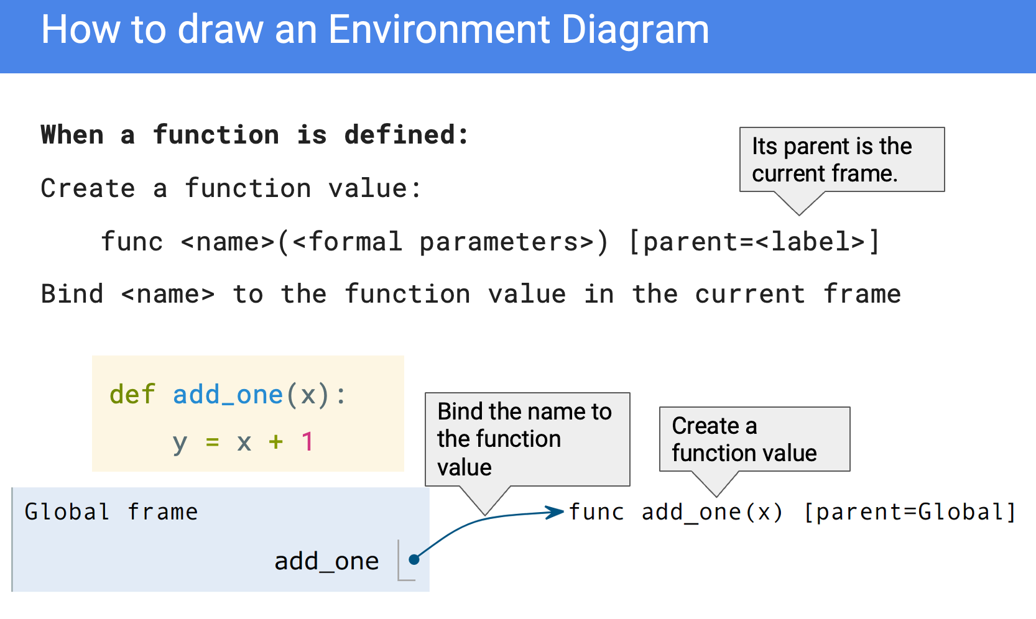
(Sep 23, Environment Diagrams, Slide Page 6)

Slide 39
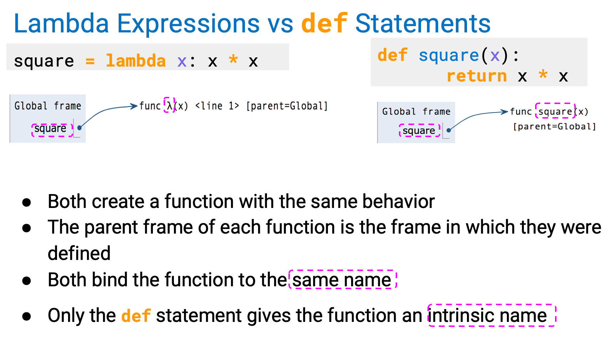
(Sep 23, Environment Diagrams, Slide Page 16)

Slide 40
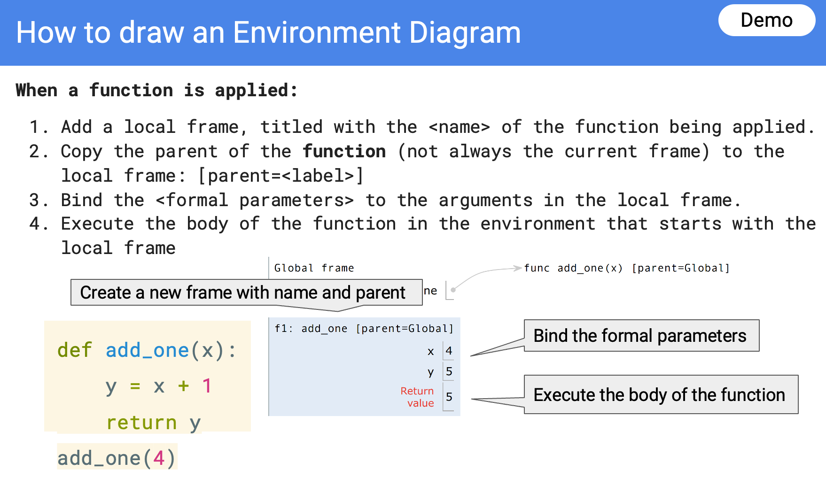
(Sep 23, Environment Diagrams, Slide Page 7)

Slide 41
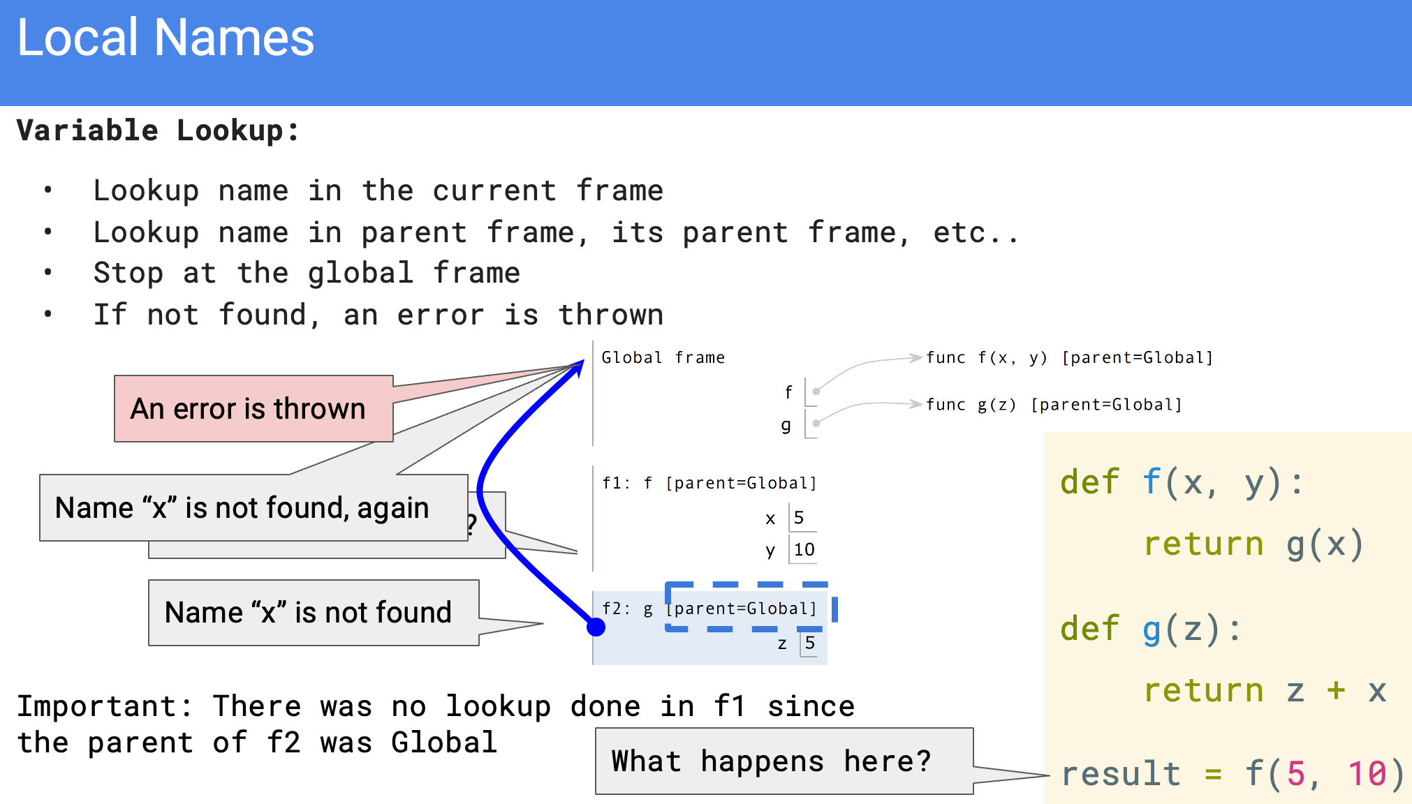
(Sep 23, Environment Diagrams, Slide Page 11)

Slide 42
Whose Reflection?

